Slide 1
Data Exploration of REMAP Dataset for Parkinson's Disease
Name: Kaiyang Qian
Date: 02/27 2025

Slide 2
Introduction
Overview of Parkinson's Disease (PD)
Purpose of REMAP Dataset
Capture real-world mobility activities in PD patients
Provide 2D/3D skeletal data and labeled Sit-to-Stand (STS) and Turning episodes
Source: University of Bristol, PD SENSORS study

Slide 3
Dataset Overview
Dataset Name: An open dataset of REal-world Mobility Activities in Parkinson's disease
Contents:
2D/3D skeletal video data (Turning & Sit-to-Stand)
Human-labeled Excel spreadsheets
Turning_human_labels.xlsx
SitToStand_human_labels.xls
Consent forms and participant information

Slide 4
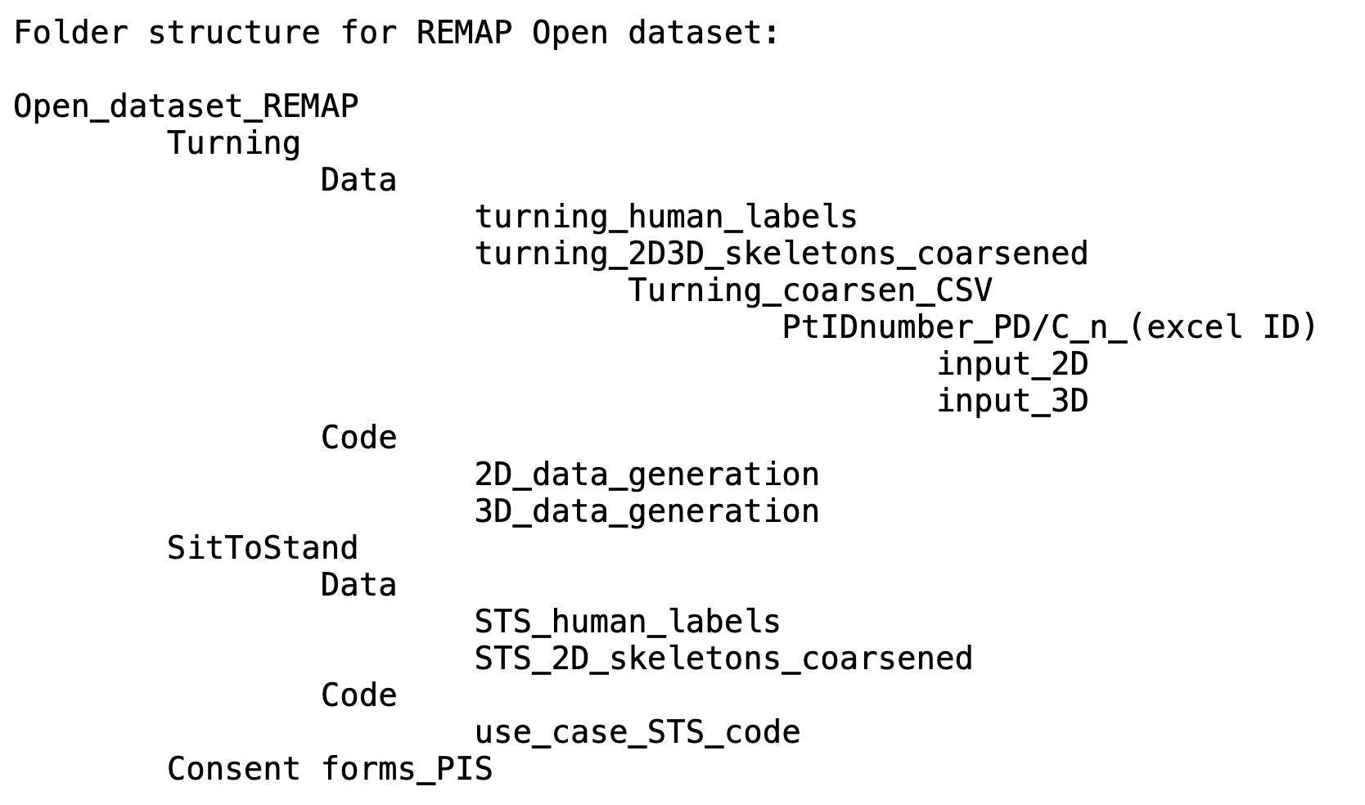
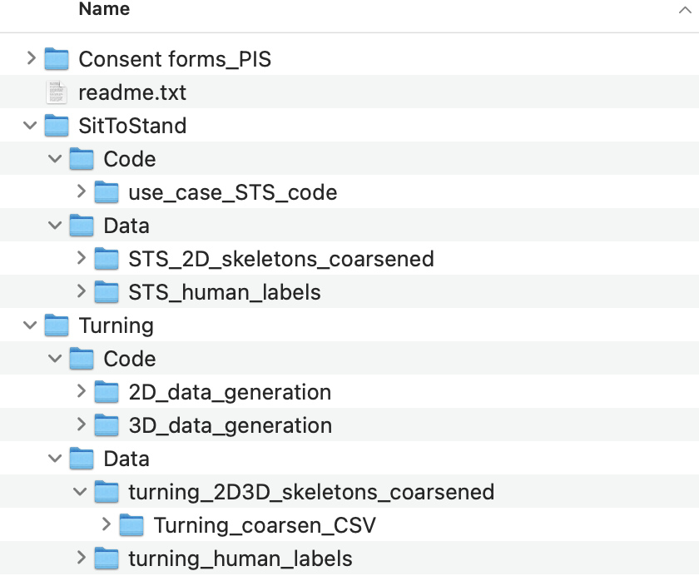
Data Structure

Slide 5
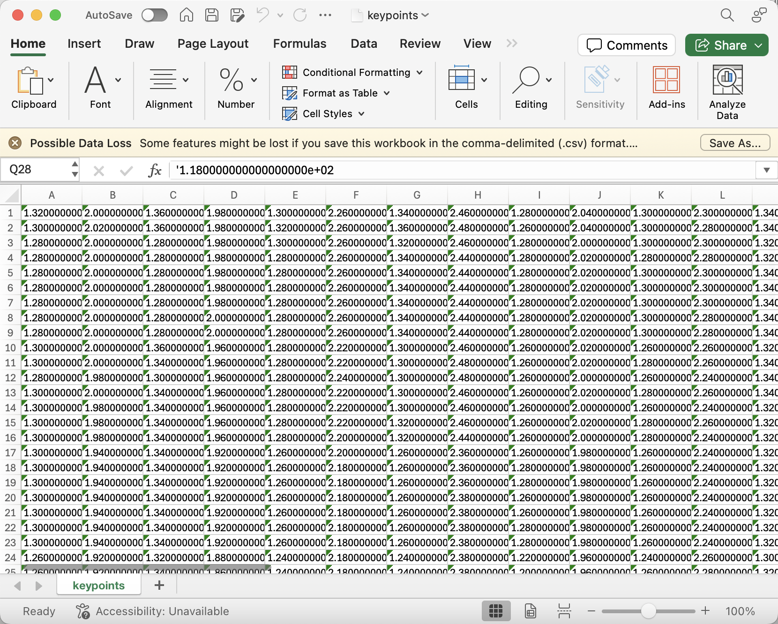
Data Structure-Turning 2D Data
Turning 2D data: The skeletal 2D data (x,y) coordinates stored in the .csv file have the following format:
1. Number of Rows: Indicate the number of frames present in the clip (e.g.Pt204_C_n_350\input_2D\keypoints.csv has 91 rows i.e. 91 frames of the clip)
2. Number of Columns (A to AH, 34 columns) : Each column indicates the (x,y) coordinate joint position values of 17 skeletal joints data starting with x0,y0, x1,y1,x2,y2………………..x17,y17 (total 34 columns)

Slide 6
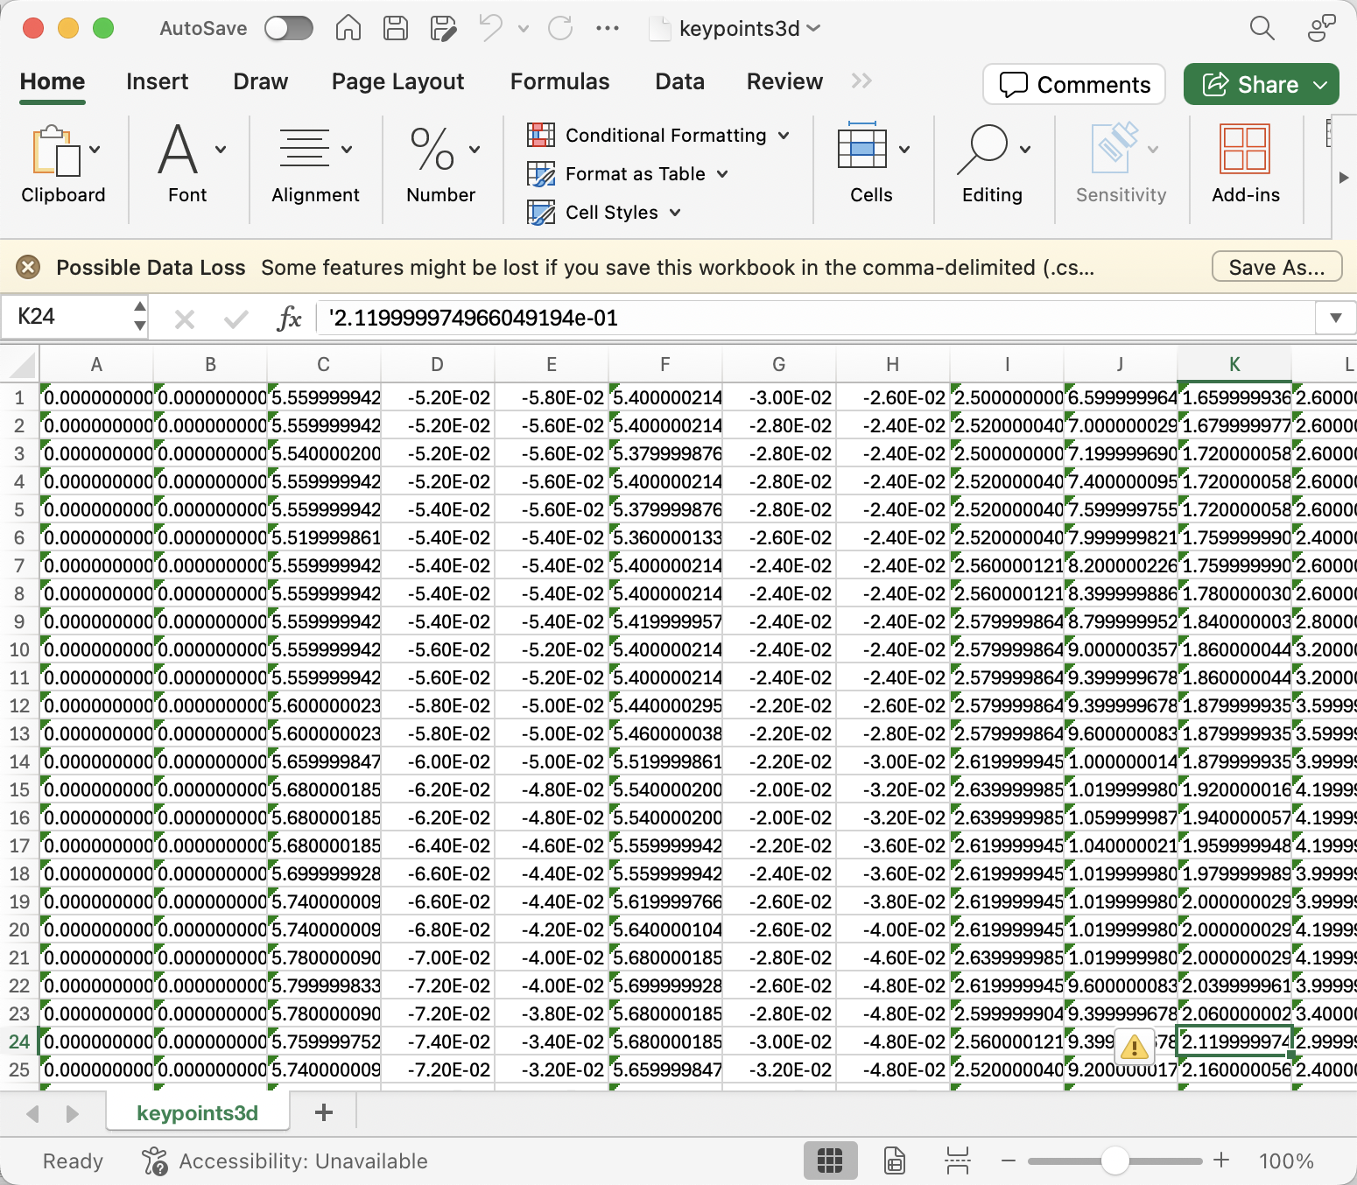
Data Structure-Turning 3D Data
Turning 3D data:
The skeletal 3D data (x,y,z) coordinates stored in the .csv file have the following format
1.Number of Rows: Indicate the number of frames present in the clip (e.g. Pt204_C_n_350\input_3D\keypoints.csv has 91 rows i.e. 91 frames of the clip)
2.Number of Columns (A to AY, 51 columns) : Each column indicates the (x,y,z) coordinate joint position values of 17 skeletal joints data starting with x0,y0,z0, x1,y1,z1,x2,y2,z2,………………..x17,y17 (total 51 columns)

Slide 7
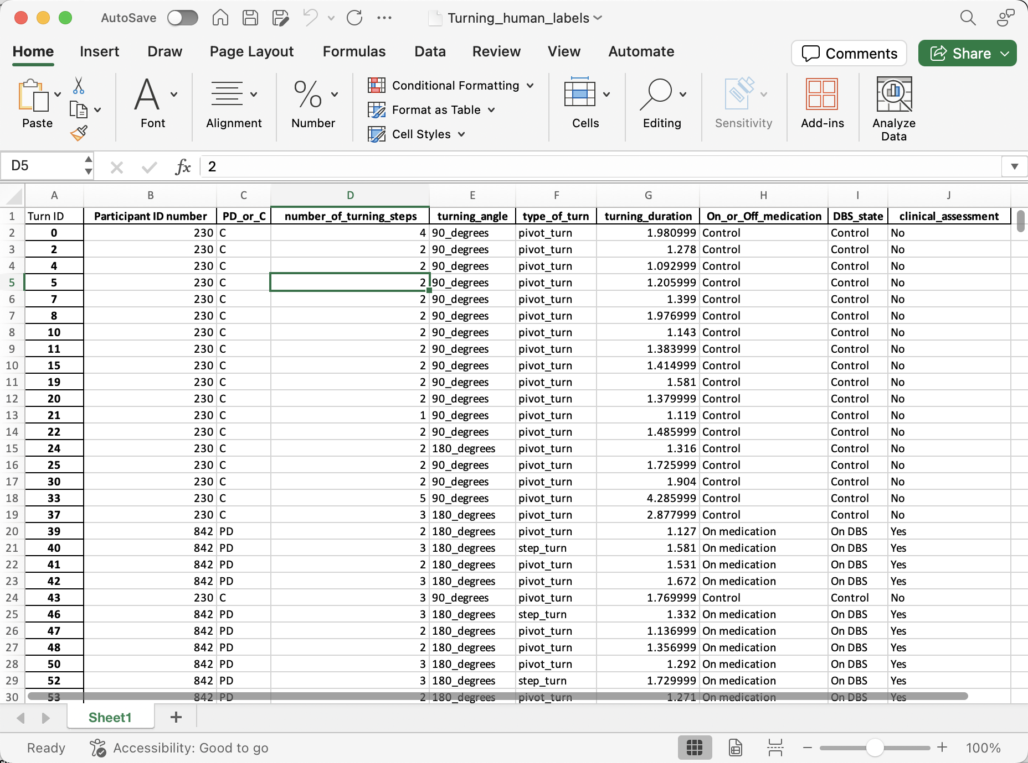
Data Structure- Turning_human_labels

Slide 8
Data Structure- Turning_human_labels
Column Letter | Heading | Description
A | Turn ID | Unique number assigned to turning episode which corresponds with the sensor data files/folder names which include 'n_[turn episode number]' for each individual turn.
B | Participant ID number | ID assigned to an individual participant.
C | PD_or_C | Type of participant (PD = person with Parkinson's disease; C = healthy control participant).
D | number_of_turning_steps | Number of steps taken by participant during their turning clip, starting after the initial foot stance, in integers.
E | turning_angle | Angle over which turn was taken, to nearest 45 degrees (e.g. range of turns assigned to 90_degrees was 67.5 to 112.5 degrees; range of turns assigned to 135_degrees was 112.5 to 157.5 degrees etc).
F | type_of_turn | Where possible to define, each turn assigned to a type of turn: 'pivot_turn' or 'step_turn'. Pivot turn = a turn in which one or both feet swivel in place to achieve the turning movement. Step turn = a turn achieved by three steps or more without pivoting.
G | turning_duration | Duration of turn in seconds.milliseconds.
H | On_or_Off_medication | Medication status. If healthy control participant: always 'Control'. If participant with Parkinson's disease: either 'On medication' or 'Off medication' (as defined by the person being in the practically-defined 'Off' medication state having withheld their long and short-acting dopaminergic medications).
I | DBS_state | Deep brain stimulation status. If healthy control participant: always 'Control'. If participant with Parkinson's disease: either 'On DBS' (deep brain stimulator switched on or within 1 hour of it being switched off), 'Off DBS' (1 hour or longer after deep brain stimulator switched off until it is switched back on again) or '-' (no deep brain stimulator in situ).
J | clinical_assessment | 'yes' indicating the turning episode took place while the participant was undergoing clinical assessments with a researcher, or 'no' indicating that the turn was captured from free-living behaviour.

Slide 9
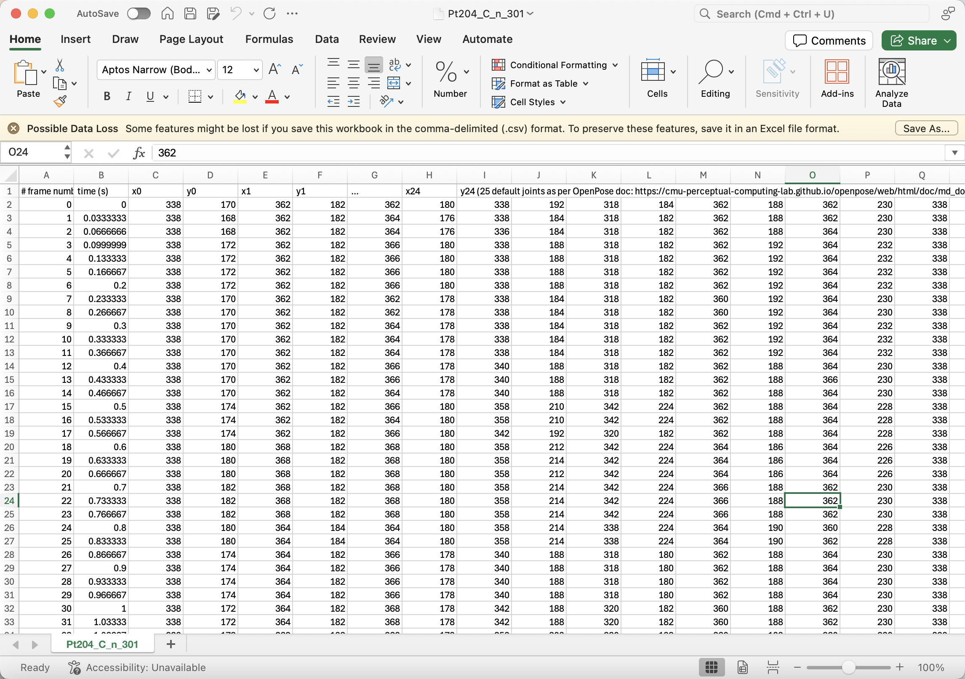
Data Structure-SitToStand_2D Data
STS 2D data:
Number of Rows: Indicates the number of frames present in the clip
Column A: # frame number
Column B: time (s) which gives an offset of the row of data relative to the starting timestamp (0) of the (.csv) file. The STS transition starts at time (s) = 2.
Number of other Columns (C to AZ, 50 columns) : Each column indicates the (x,y) coordinate joint position values of 25 skeletal joints data starting with x0,y0, x1,y1,x2,y2………………..x25,y25 (total 50 columns)

Slide 10
Data Structure - SitToStand_human_labels
Column Letter | Heading | Description
A | Transition ID | Unique number assigned to turning episode which corresponds with the sensor data files/folder names which include 'n_[STS episode number]' for each individual STS transition episode.
B | Participant ID number | ID assigned to an individual participant.
C | PD_or_C | Type of participant (PD = person with Parkinson's disease; C = healthy control participant).
D | sts_whole_episode_duration | Duration in seconds of 'whole episode duration' label which started when the participant made their first motion towards standing from a static sitting position and ended when the person was fully upright.
E | sts_final_attempt_duration | Duration in seconds of 'final attempt duration' label in milliseconds, comprising their impression of the duration between the lowest point of the head (start) and when the person was fully upright/the maximum vertical position of the vertex of the head (end).
F | On_or_Off_medication | Medication status. If healthy control participant: always 'Control'. If participant with Parkinson's disease: either 'On medication' or 'Off medication' (as defined by the person being in the practically-defined 'Off' medication state having withheld their long and short-acting dopaminergic medications).
G | DBS_state | Deep brain stimulation status. If healthy control participant: always 'Control'. If participant with Parkinson's disease: either 'On DBS' (deep brain stimulator switched on or within 1 hour of it being switched off), 'Off DBS' (1 hour or longer after deep brain stimulator switched off until it is switched back on again) or '-' (no deep brain stimulator in situ).
H | clinical_assessment | 'yes' indicating the turning episode took place while the participant was undergoing clinical assessments with a researcher, or 'no' indicating that the turn was captured from free-living behaviour.
I | STS_additional_features | A note to describe extra features of the STS episode: 'slow' (subjective rating), 'Uses arms of chair' (which denotes using nearby flat surface to lever up from chair to standing), 'Moves forward in chair' (prior to standing up), '>1 attempt' (person tries more than once to get up before being successful), 'Carrying something' (in hands), 'Moves forward in chair' (prior to standing up), 'unable to arise without help'.
J | MDS-UPDRS_score_3.9 _arising_from_chair | A score from 0-4 assigned to each STS episode, with scoring criteria from the MDS-UPDRS (Movement Disorders Society-sponsored revision of the Unified Parkinson's Disease Rating Scale) part 3.9. 0 = normal; 4 = unable to arise without help.

Slide 11
Extra information about "on" and "off" medication labels
Throughout the dataset, the sensor data, human rater labels, clinical rating scale scores etc have often been assigned to "on" medications (with medications alleviating symptoms) or "off" medications (with increase symptom severity) for the person with Parkinson’s.
"off" medications = the person with Parkinson's disease was in a practically-defined "off" medications state, having withheld their long-acting dopaminergic medications for >24 hours and their short-acting dopaminergic medications for >12 hours.
"on" medications = the rest of the data was taken to be in the "on" medications state, i.e. the person had not withheld their dopaminergic medications for the pre-specified time periods.

Slide 12
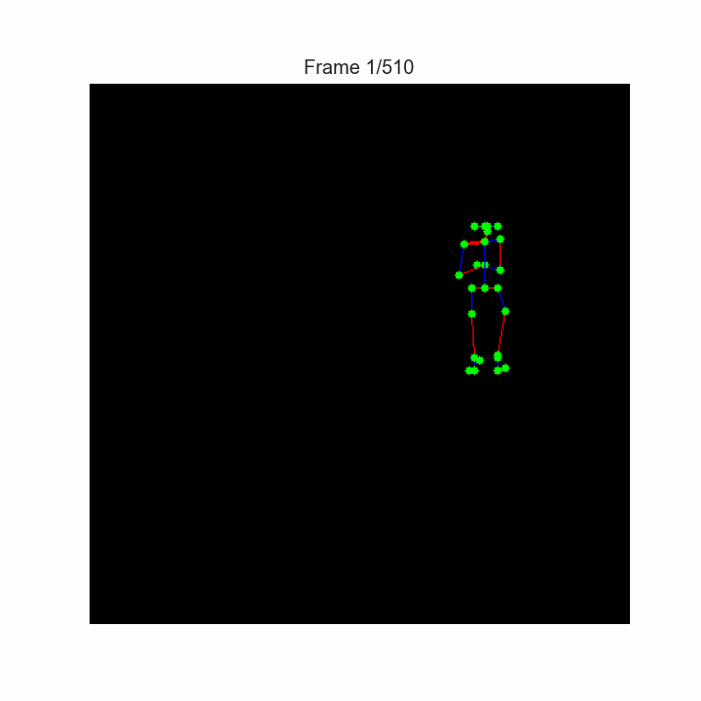
Examples – SitToStand_2D Data

Slide 13
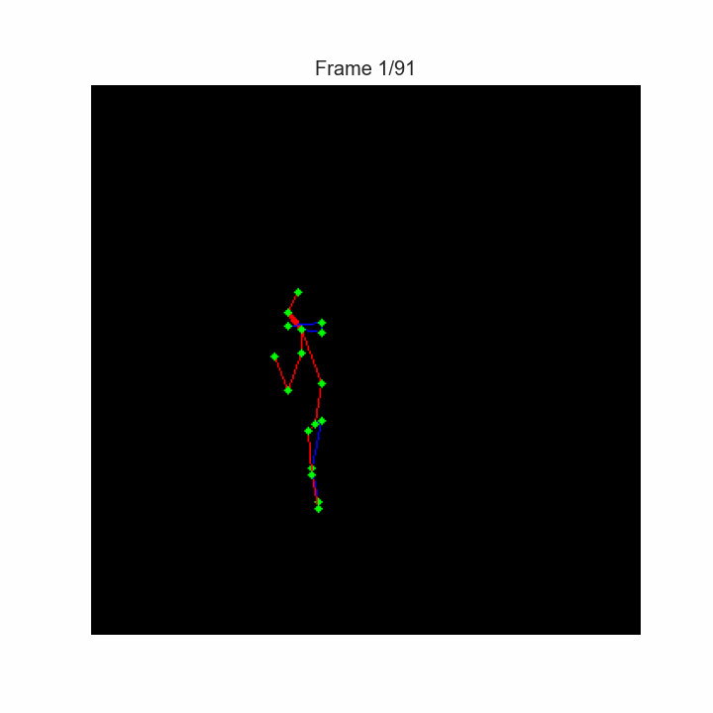
Examples – Turning_2D Data

Slide 14
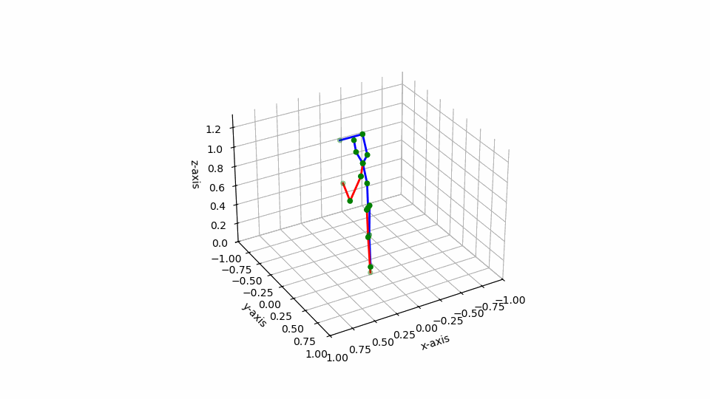
Examples – Turning_3D Data

Slide 15
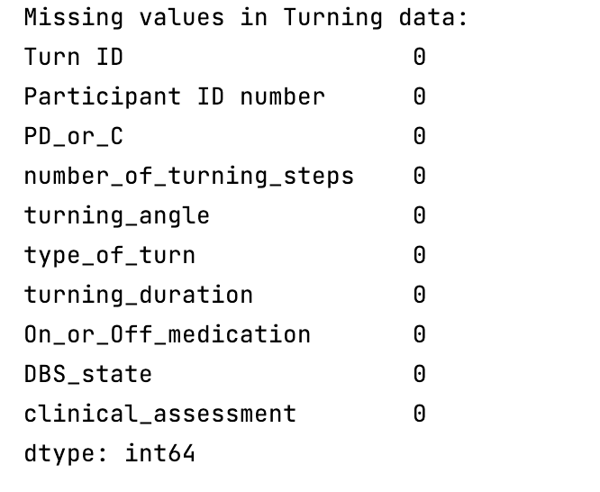
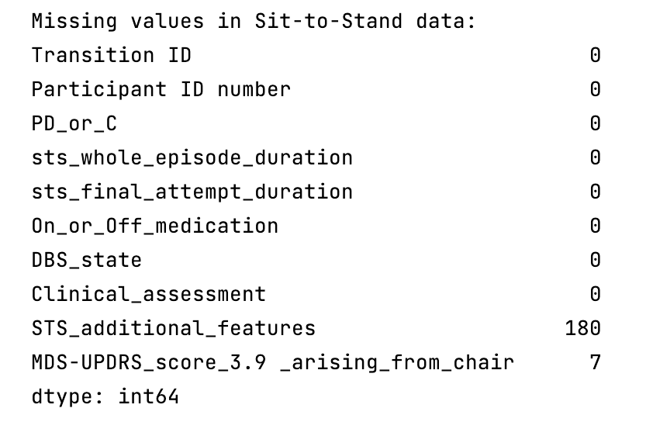
Data Exploration – Check Missing Data
# Check the dimensions (rows and columns) print("Sit-to-Stand data shape:", sit_to_stand_df.shape) print("Turning data shape:", turning_df.shape) # Quick look at missing values in each dataset print("\nMissing values in Sit-to-Stand data:") print(sit_to_stand_df.isnull().sum()) print("\nMissing values in Turning data:") print(turning_df.isnull().sum())

Slide 16
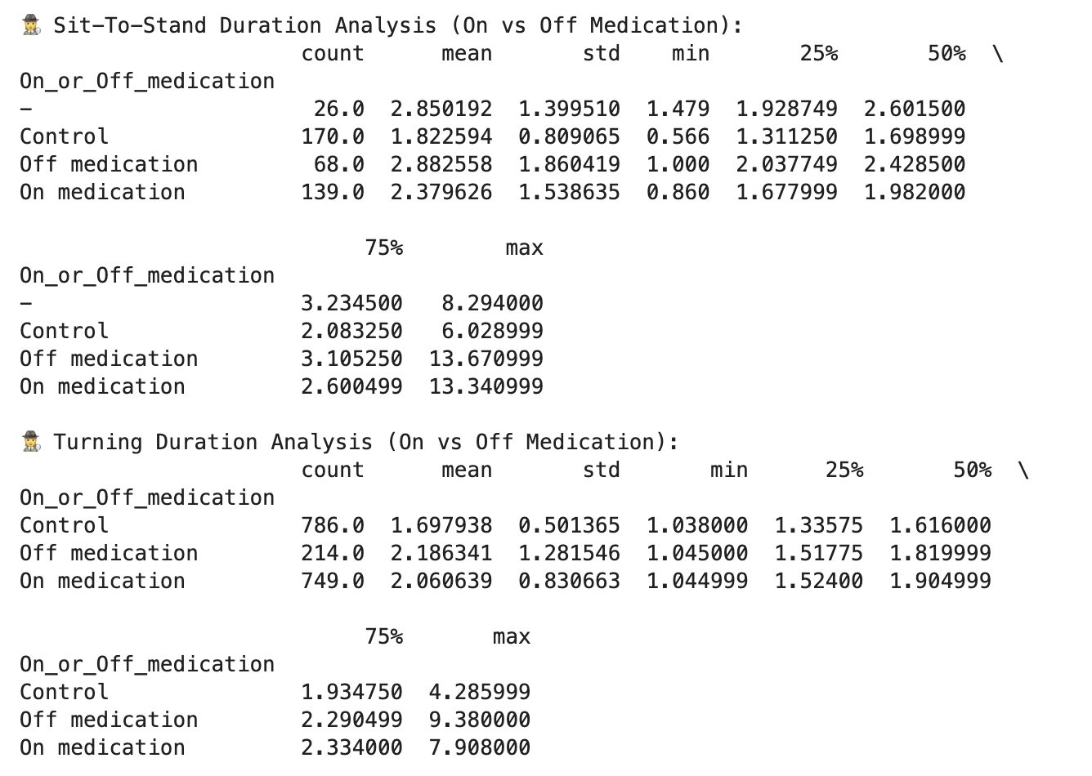
Data Exploration – Duration Analysis
# Sit-to-stand duration analysis by medication status print("\n🕵️ Sit-To-Stand Duration Analysis (On vs Off Medication):") print(sit_to_stand_df.groupby('On_or_Off_medication')['sts_whole_episode_duration'].describe()) # Turning duration analysis by medication status print("\n🕵️ Turning Duration Analysis (On vs Off Medication):") print(turning_df.groupby('On_or_Off_medication')['turning_duration'].describe())

Slide 17
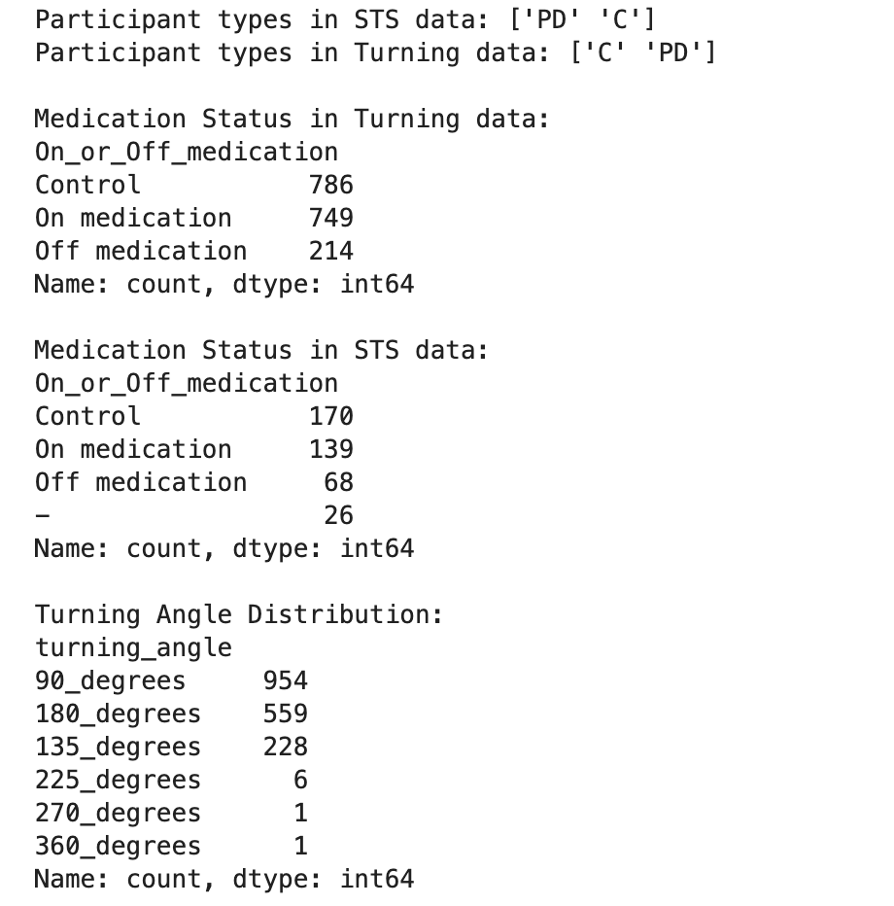
Data Exploration
# For participant type (PD or Control) print("Participant types in STS data:", sit_to_stand_df["PD_or_C"].unique()) print("Participant types in Turning data:", turning_df["PD_or_C"].unique()) # Count frequency of medication status print("\nMedication Status in Turning data:") print(turning_df["On_or_Off_medication"].value_counts()) print("\nMedication Status in STS data:") print(sit_to_stand_df["On_or_Off_medication"].value_counts()) # Distribution of turning angles print("\nTurning Angle Distribution:") print(turning_df["turning_angle"].value_counts())

Slide 18
Data Exploration- Distribution of Turning Steps
sns.histplot(turning_df["number_of_turning_steps"], bins=range(int(turning_df["number_of_turning_steps"].min()), int(turning_df["number_of_turning_steps"].max()) + 1), kde=False) plt.title("Distribution of Turning Steps") plt.xlabel("Number of Turning Steps") plt.ylabel("Count") plt.show()

Slide 19
Data Exploration- Turning Duration by Participant Type
import seaborn as sns import matplotlib.pyplot as plt sns.boxplot(x="PD_or_C", y="turning_duration", data=turning_df) plt.title("Turning Duration by Participant Type") plt.xlabel("Participant Type") plt.ylabel("Turning Duration (s)") plt.show()

Slide 20
Data Exploration- STS Whole Episode Duration by Participant Type
sns.boxplot(x="PD_or_C", y="sts_whole_episode_duration", data=sit_to_stand_df) plt.title("STS Whole Episode Duration by Participant Type") plt.xlabel("Participant Type") plt.ylabel("Whole Episode Duration (s)") plt.show()

Slide 21
Data Exploration
# Boxplot for turning duration plt.figure(figsize=(8, 6)) sns.boxplot(data=turning_df, x='On_or_Off_medication', y='turning_duration') plt.title('Turning Duration (On vs Off Medication)') plt.xlabel('Medication Status') plt.ylabel('Turning Duration (seconds)') plt.show() # Boxplot for sit-to-stand duration plt.figure(figsize=(8, 6)) sns.boxplot(data=sit_to_stand_df, x='On_or_Off_medication', y='sts_whole_episode_duration') plt.title('Sit-to-Stand Duration (On vs Off Medication)') plt.xlabel('Medication Status') plt.ylabel('Sit-to-Stand Duration (seconds)') plt.show()

Slide 22
End

